Slide 1
Simulation and Modeling
CSE4131_CSE4132

Slide 2
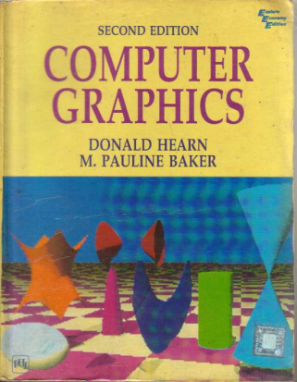
Reference Book
Computer Graphics (2nd Edition)
D. HEARN
M. P. BAKER

Slide 3
A Silly Question
Which one is to build first?
Simulation or Model?
Definitely we have to build Model first
Then use the model for simulation

Slide 4
Computer Representation of a Model
Recall –
We are interested in mathematical model
Mathematical model ⇨ number +symbols + equations
Computer representation ⇨ numbers and equations
Nothing to say.
But more perceivable if graphically represented…
Graphically representation ⇨ 2D or 3D
Usually we prefer 3D graphics represenatation.

Slide 5
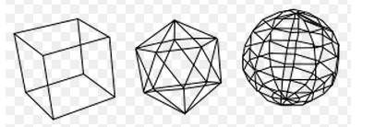
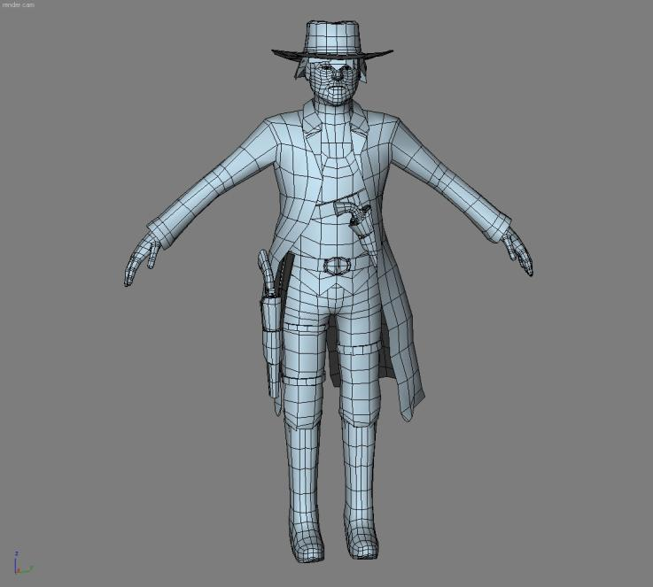
Computer Representation of a Model
3D Model
Wireframe model
Solid Model
A wire frame model is a visual presentation of a 3 dimensional or physical object used in 3D computer graphics.
created by specifying each edge of the physical object where two mathematically continuous smooth surfaces meet,
or by connecting an object's constituent vertices using straight lines or curves.

Slide 6
3D Object Representation
Graphics scenes can contain many different kinds of objects:
flowers, clouds, rocks, water, bricks, wood paneling, rubber, paper, marble, steel, glass, plastic, cloth….
There is no one method that we can use to describe objects that will include all characteristics of these different materials.
…. we need to use representations that accurately model object characteristics.

Slide 7
3D Object Representation
Representation of Object
2 broad categories
Boundary representations (B-reps)
describe a three-dimensional object as a set of surfaces that separate the object interior from the environment.
E.g. polygon facets and spline patches.
Space-partitioning
These representations are used to describe interior properties, by partitioning the spatial region containing an object into a set of small, non-overlapping, contiguous solids (usually cubes).
E.g. Octrees

Slide 8
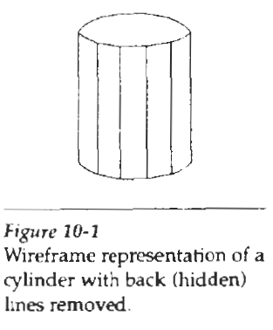
Boundary representations (B-reps)
The most commonly used boundary representation … for a 3-dimensional graphics object is a set of surface polygons that enclose the object interior. (Polygon: a two-dimensional geometric figure formed of three or more straight lines)
This simplifies and speeds up the surface rendering(অনুবাদ) and display of objects, since all surfaces are described with linear equations.
Often referred as ” Standard Graphics Object”

Slide 9
Polygon Tables
We specify a polygon surface with
a set of vertex coordinates and
associated attribute parameters.
Vertex – highest point
Polygon data tables can be organized into two groups:
Geometric tables and
Attribute tables.

Slide 10
Geometric Tables
A convenient organization for storing geometric data is to create three lists:
A Vertex Table, (Vertex → highest point )
An Edge Table, And (Edge → boundary/ border )
A Polygon Table Or Polygon Surface Table (Polygon →a two-dimensional geometric figure formed of three or more straight sides)

Slide 11
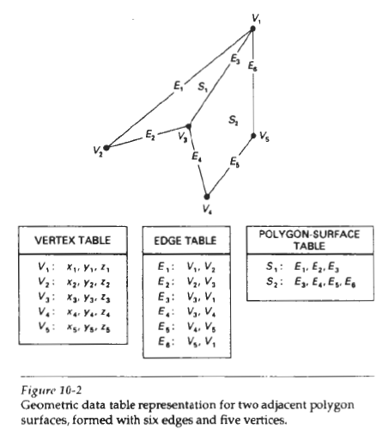
Geometric Tables
Coordinate values for each vertex in the object are stored in the vertex table.
The edge table contains pointers back into the vertex table to identify the vertices for each polygon edge.
And the polygon table contains pointers back into the edge table to identify the edges for each polygon.

Slide 12
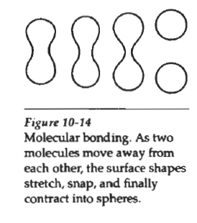
Blobby Objects
Some objects do not maintain a fixed shape, but change their surface characteristics in certain motions or when in proximity to other objects
Examples in this class of objects include:
molecular structures, water droplets and other liquid effects, melting objects, and muscle shapes in the human body

Slide 13
Spline Representations
A spline is a flexible strip used to produce a smooth curve through a designated set of points.
Several small weights are distributed along the length of the strip to hold it in position on the drafting table as the curve is drawn.
The term spline curve originally referred to a curve drawn in this manner.
We can mathematically describe such a curve with a piecewise cubic polynomial function
whose first and second derivatives are continuous across the various curve sections

Slide 14
Spline Representations
The term spline curve now refers to any composite Curve formed with polynomial section satisfying specified continuity conditions at the boundary of the pieces.
A spline surface can be described with two sets of orthogonal spline curves.
Orthogonal means mutually independent, non-redundant, non-overlapping, or irrelevant

Slide 15
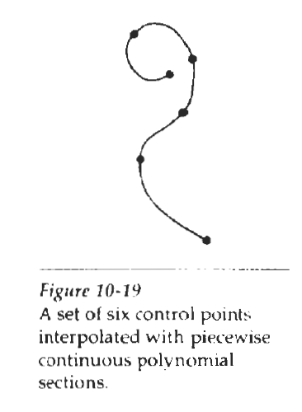
Interpolation and Approximation Spline
We specify a spline curve by giving a set of coordinate positions, called control points, which indicates the general shape of the curve.
When polynomial sections are fitted so that the curve passes through each control point, the resulting curve is said to interpolate the set of control points.

Slide 16
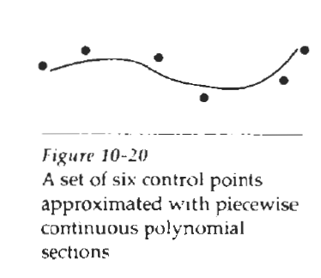
Interpolation and Approximation Spline
When the polynomials are fitted to the general control-point path without necessarily passing through any control point, the resulting curve is said to approximate the set of control points

Slide 17
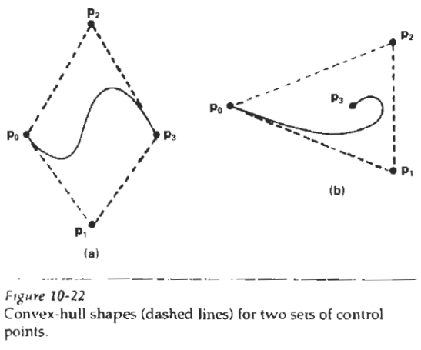
Convex Hull
Convex → Curved
Hull → Outer Covering
The convex polygon boundary that encloses a set of control points is called the convex hull.

Slide 18

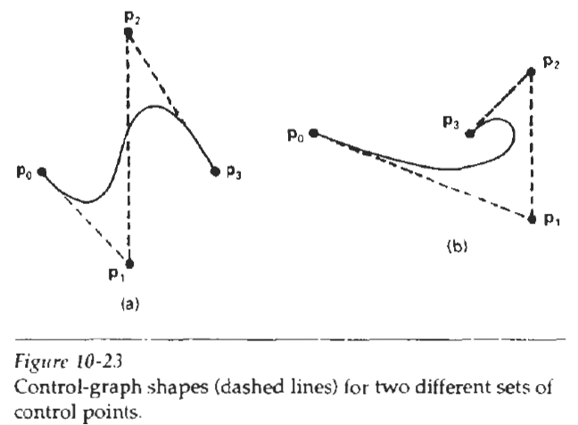
Control Graph
A polyline connecting the sequence of control points for an approximation spline is usually displayed to remind a designer of the control-point ordering.
This set of connected line segments is often referred to as the control graph of the curve.
Also Called: control polygon and characteristic polygon.

Slide 19
Parametric Continuity Conditions
To ensure a smooth transition from one section of a piecewise parametric curve to the next, we can impose various continuity conditions at the connection points.
If each section of a spline is described with a set of parametric coordinate functions of the form:
we set parametric continuity by matching the parametric derivatives of adjoining
curve sections at their common boundary.

Slide 20
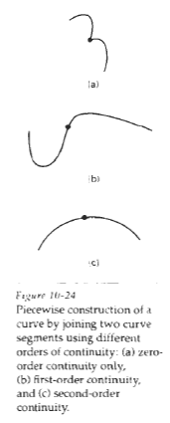
Parametric Continuity Conditions
Zero-order parametric continuity,
described as C⁰ continuity, means simply that the curves meet. That is, the values of x, y, and z evaluated at u₂ for the first curve section are equal, respectively, to the values of x, y, and z evaluated at u₁ for the next curve section
First-order parametric continuity,
referred to as C¹ continuity, means that the first parametric derivatives (tangent lines) of the coordinate functions in Eq. 10-20 for two successive curve sections are equal at their joining point.
Second-order parametric continuity,
Or C² continuity, means that both the first and second parametric derivatives of the two curve sections are the same at the intersection, Higher-order parametric continuity conditions are defined similarly.
Figure 10-24 shows examples of C⁰, C¹, and C² continuity.

Slide 21
Spline Specifications
There are three equivalent methods for specifying a particular spline representation:
We can state the set of boundary conditions that are imposed(ধার্য) on the spline;
We can state the matrix that characterizes the spline;
We can state the set of blending functions (or basis functions) that determine how specified geometric constraints (বাধ্য করা) on the curve are combined to calculate positions along the curve path.

Slide 22
Some Commonly Used Splines
Some commonly used splines and their matrix and blending-function specifications
Cubic Spline Interpolation Method
Natural Cubic Splines
Hermit Spline
Cardinal Splines
Kochanek-Bartels Splines

Slide 23
Cubic Spline Interpolation Method
This class of splines is most often used to:
set up paths for object motions or
to provide a representation for an existing object or drawing, +
also used sometimes to design object shapes.
Cubic polynomials offer a reasonable compromise between flexibility and speed of computation.
Compared to higher-order polynomials, cubic splines require less calculations and memory and they are more stable.
Compared to lower-order polynomials, cubic splines are more flexible for modeling arbitrary curve shapes

Slide 24
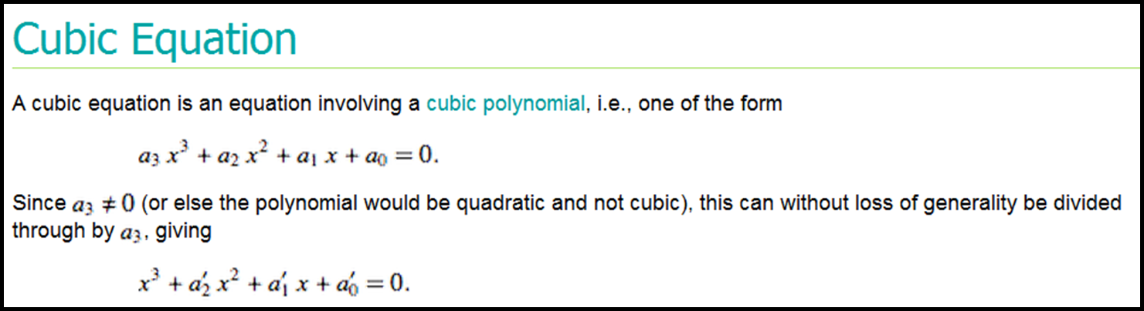

Slide 25

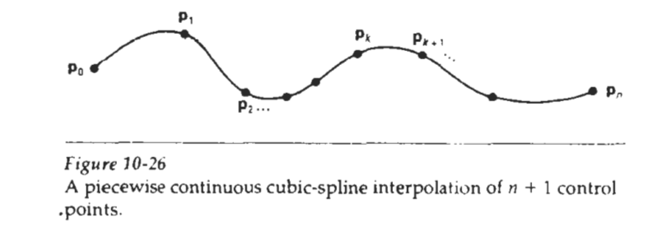
Cubic Spline Interpolation Method
Given a set of control points,
cubic splines interpolation are obtained by fitting the input points with a piecewise cubic polynomial curve that passes through every control point.
Suppose we have n + 1 control points specified with coordinates
A cubic interpolation fit of these points is illustrated in Fig. 10-26

Slide 26
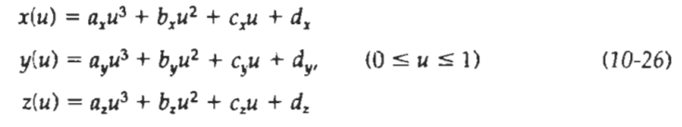
Cubic Spline Interpolation Method
We can describe the parametric cubic polynomial that is to be fitted between each pair of control points with the following set of equations:
For each of these three equations, we need to determine
We do this by the values of the four coefficients a, b, c, and d in the polynomial representation for each of the n curve sections between the n + 1 control points.

